Slide 1

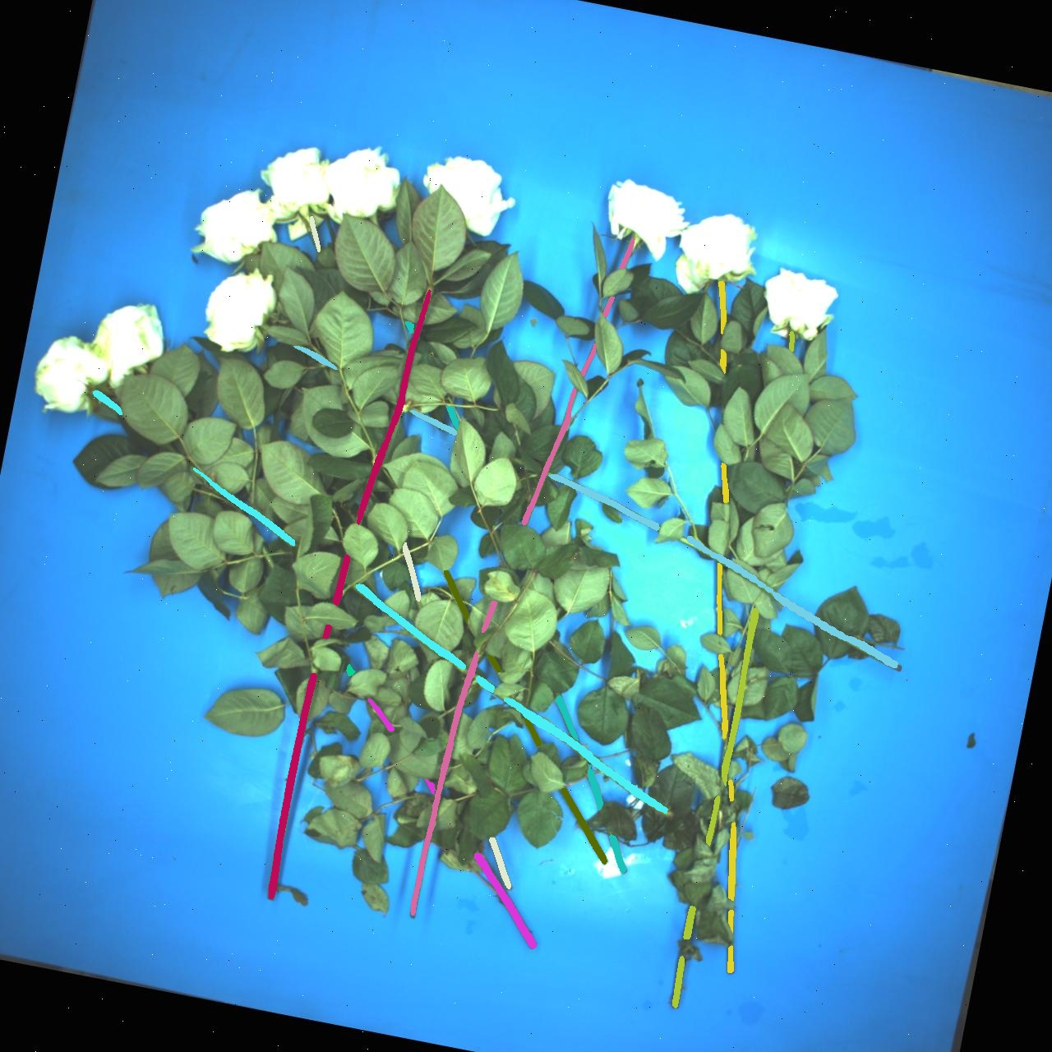
Optimization4 of Stem Pairing
Week 11 Hua Jiang

Slide 2
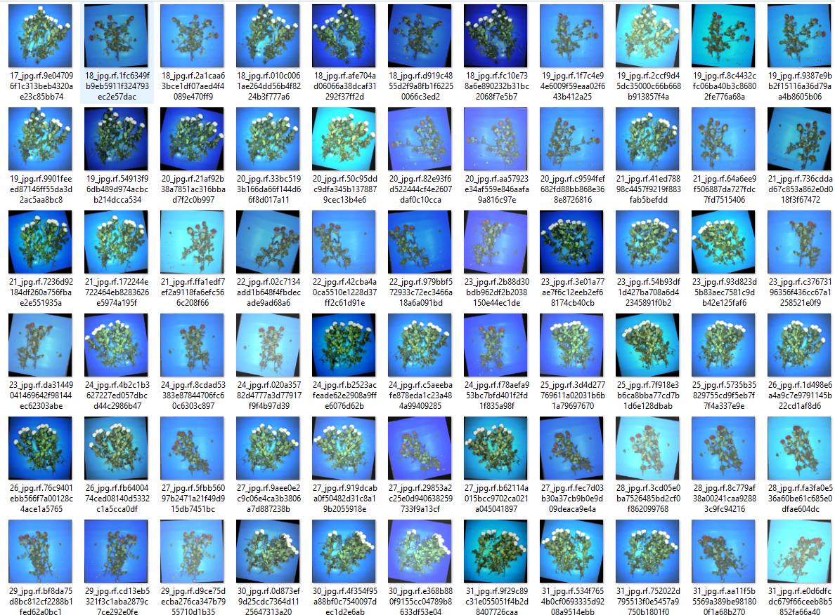
Tunning parameters and I changed the main pairing strategy!
Successfully passed the test sets from 19 – 32, around 66 images

Slide 3

Compare only distance
Candidate scores
Base Stem
If
Else
Check candidates with score <3
True Partner
If
No
Compare distance*score
Check candidates with 3< score <11
Best candidate
No
Yes
Yes
Check candidates with 11< score
Yes
Compare only score
Output
We don’t want to only pick up the candidate with the lowest score, not high chance to be correct

Slide 4
Base Stem i
Candidate Stem j: scores_i_j
Reversely, find score_j_i
+
Pairing is not unilateral, it’s bilateral:
score_i_j: the score of stem j based on stem i
score_j_i: the score of stem i based on stem j
Instead of choosing the lowest candidate score, find the lowest matching score!
From candidate j_1 to j_k, find the lowest score_i_j +score_j_i
Output: best candidate
That curtails the line of code from 1600 to 1100, increase the computational speed by 2-3 times, with generally 100% accuracy!

Slide 5
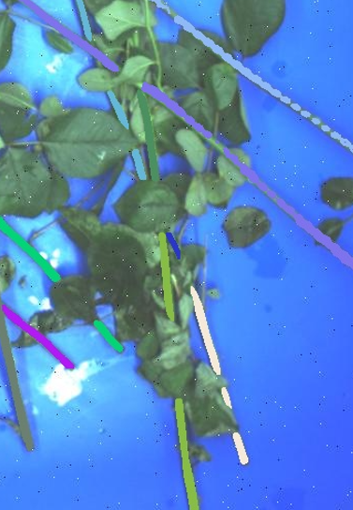
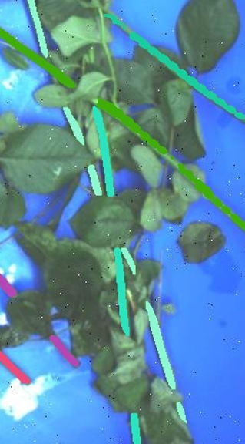
Base Stem i
3
1
Candidate Stem j: scores_i_j
Reversely, find score_j_i
+
4
2
5
From candidate j_1 to j_k, find the lowest score_i_j +score_j_i
Output: best candidate
That curtails the line of code from 1600 to 1100, increase the computational speed by 2-3 times, with generally 100% accuracy!

Slide 6
Future Work:
Validate on the rest 70 images and tune the parameter
Test on a new dataset for overall accuracy
Implement the ‘Top Selection’algorithm.

